Slide 1


Benchmarking

Slide 2
benchmarking

Slide 3
why?
Notes:
tell a story about assembly line queueing in process systems.

Slide 4
fabrication
phones
rockets
books
Notes:
manufacturing has traditionally had many “SPOF”s on the assembly line.
Removing the database SPOFs saves a ton of effort.

Slide 5
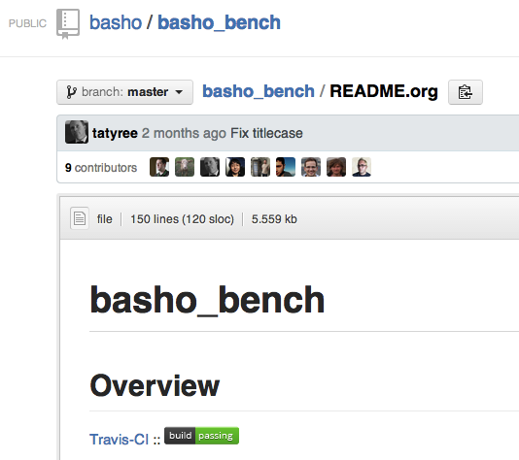

Slide 6

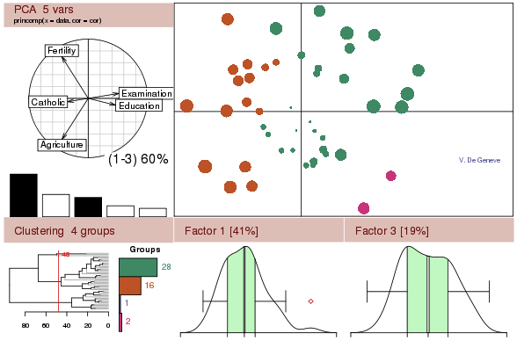

Slide 7
basho_bench
is NOT...
Notes:
your production system, a reflection of your development system, a good reflection of your devrel against your production, UAT, dev, test or other environment.
basho_bench is basho_bench... it shows a set baseline - don’t compare it to what you’re trying to do. ....and that leads me to...

Slide 8
benchmarking
Notes:
Definition: A standard by which something can be measured or judged

Slide 9
benchmark
for success...
Notes:
You might have heard “benchmark for success” that’s dumb.

Slide 10

Notes:
Ok, that just sounds stupid...

Slide 11
what?
Notes:
What actually needs measured?

Slide 12
story
Notes:
What’s the story behind the business at hand?

Slide 13
measure

Slide 14
#win
...with benchmarking

Slide 15
Notes:
Ok, that just sounds stupid...

